Slide 1
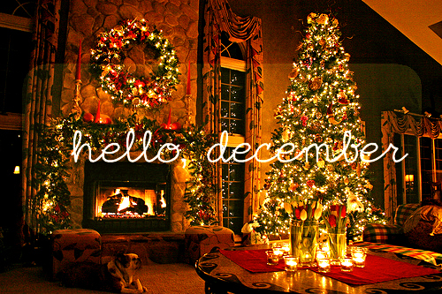
DECEMBER

Slide 2
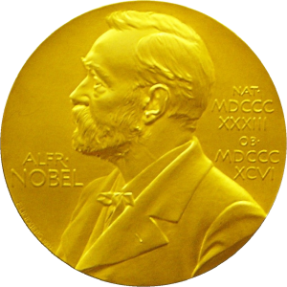
10th December Nobel Peace Day

Slide 3
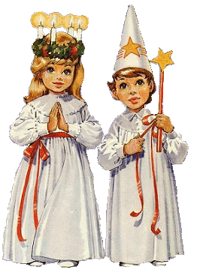
13th December Lucia

Slide 4
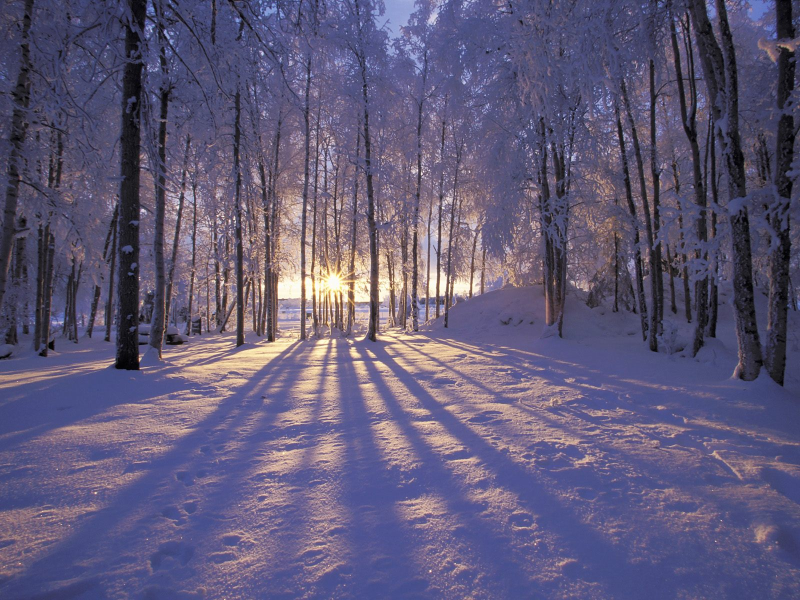
21th December Winter Solstice

Slide 5
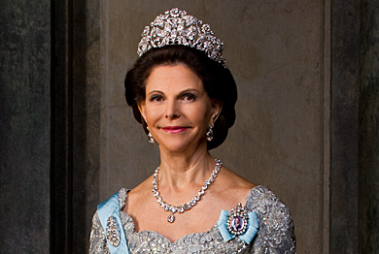
23th December The Queen’s Birthday

Slide 6
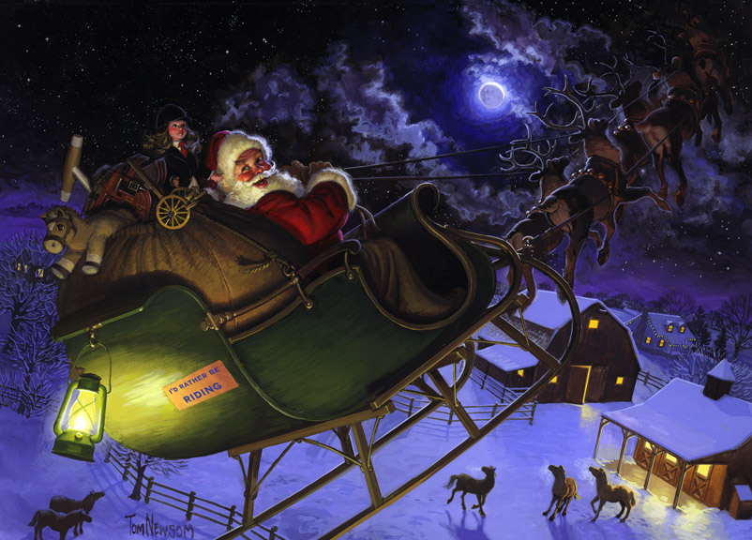
24th December Christmas Eve

Slide 7
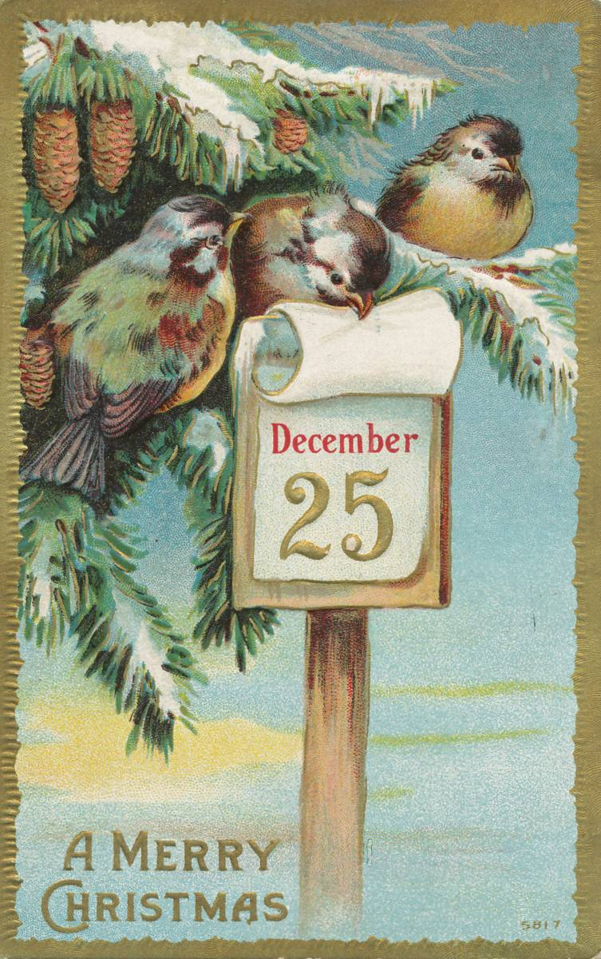
25th December Christmas Day

Slide 8
26th December Boxing Day

Slide 9
31th December New Year’s Eve

